Slide 1
Cybersecurity
Spoofing

Slide 2

Spoofing
Pretending to be someone else
  Fake web server
  Fake DNS server
  Fake Wireless Access Point
Email address spoofing
  Falsifying the sending address of an email
Caller ID spoofing
  Falsifying Caller ID information

Slide 3
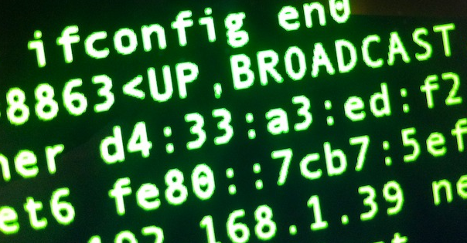
MAC Spoofing
Each device has a MAC address
  Unique Hexadecimal address burned in by manufacturer
  (MACs are unique to each manufacturer)
  Drivers allow you to change which MAC is used
  Used for good
    ISP requires certain MAC address
    Certain applications require a particular MAC address to respond
  Used for bad
    Defeat MAC-based ACLs
    Get around wireless address filter
Hard to spot
  Which of these MACs is the real one?!

Slide 4

IP Address Spoofing
Use another device’s IP address
  Pretend to be somewhere you are not
Used for good
  Load balancing
  Load testing
  (trying new server setup without formally changing DNS)
Used for bad
  ARP poisoning
  DNS amplification/DDoS
Easier to spot than MAC address spoofing
  Apply rules to prevent invalid traffic
  Enable switch security

